Slide 1
Manthan’s Grocery Center
Course name --- Object Oriented Programming
Course Code – CSC 450
Prof name – Prof Shukri Abotteen

Slide 2
Welcome to Manthan's Grocery Center
01
02
About us
Project Information
03
04
Outputs
Demo

Slide 3
About US

Slide 4
Database.java
This class establishes a connection to your MySQL database using JDBC.
It's essential for interacting with your database, performing queries, and managing data.
The connection details (URL, username, password) are hardcoded, which is fine for development but consider using environment variables or a configuration file for production to enhance security.
with your own text.

Slide 5
Authentication (`Authentication.java`)
The `Authentication` class handles user login and registration. It queries the database to check if user credentials are correct or if a username already exists during registration. This class is crucial for securing access to your application, ensuring that only registered users can make purchases or view their order history.

Slide 6
Product Catalog (`ProductCatalog.java`)
This class allows users to view product categories and products within a selected category. It’s a
vital part of the user experience, enabling customers to browse your inventory. Implementing this functionality requires careful database design to ensure that products and categories are well-organized and easy to navigate.

Slide 7
Order Processing (`OrderProcessing.java`)
Order processing involves managing shopping carts, adding or removing products, and calculating
totals. This class likely interacts closely with the database to update the cart contents for each user and to keep track of stock levels. It's important to handle these operations efficiently to ensure a smooth checkout process for users.

Slide 8
Payment Processing (`PaymentProcess.java`)
While the details of the `PaymentProcess` class weren't fully explored, it's clear that this component would handle the financial transactions. Integrating with a payment gateway would be the nextstep, allowing for secure credit card processing or other payment methods. This part of the system must be robust and secure, complying with payment card industry standards to protect user data.

Slide 9
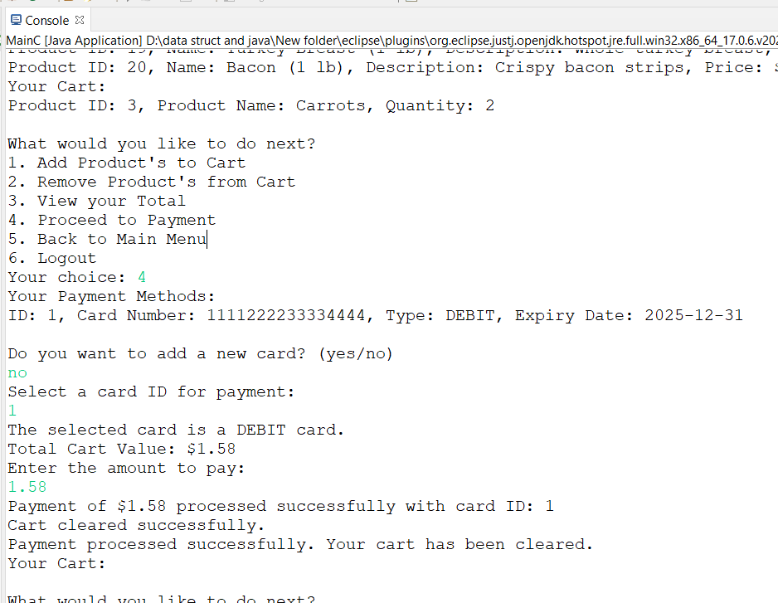
Project Output

Slide 10
THANK YOU

